Slide 1
2020-07-07 Presentation
Salih Fırat Canpolat

Slide 2
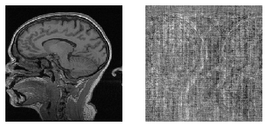
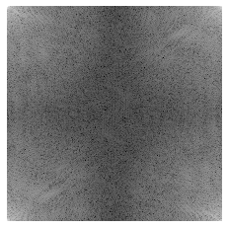
The Dataset
Single channel data from Multi-channel MR Image Reconstruction Challenge (MC-MRRec) is used.
25 training, 10 validation cases with 170, 256, 256, 2 shape (sampe, hy, hx, complex)
Magnitude
Phase
K-Space

Slide 3
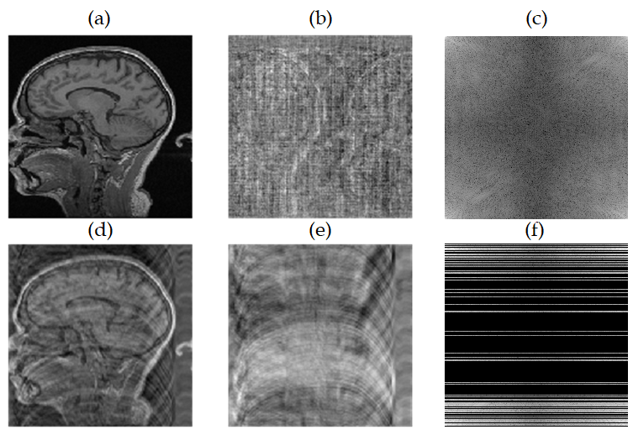
Undersampling
Cartesian sampling with 1 sample on center, 4 times acceleration, with no centering was used, 10 lines at the borders were used.
Data loader fed the model with the mask uniquely generated for each sample and each epoch.
Undersampling was done within the model except for magnitude input.

Slide 4
Models
U-Net 2x
DumbellXL 2x (Add)
DumbellXL 2x (Concat)
DumbellXL 3x (Concat)
DumbellS 6x (Concat)

Slide 5
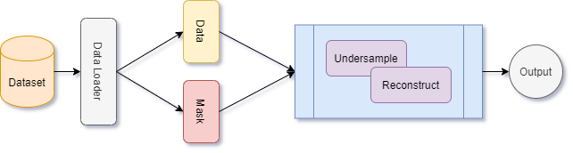
Reconstruction Operation Overview

Slide 6
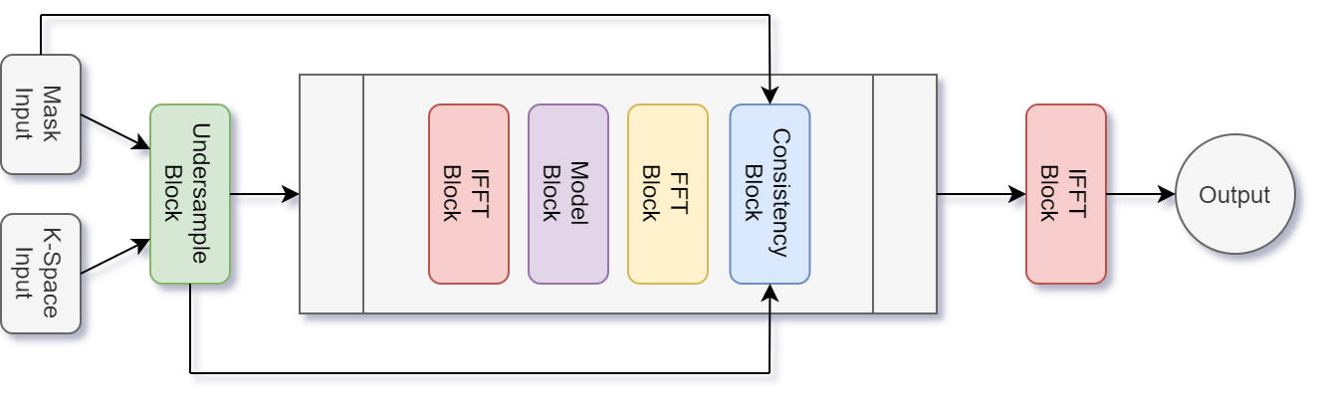
Architecture Overview

Slide 7
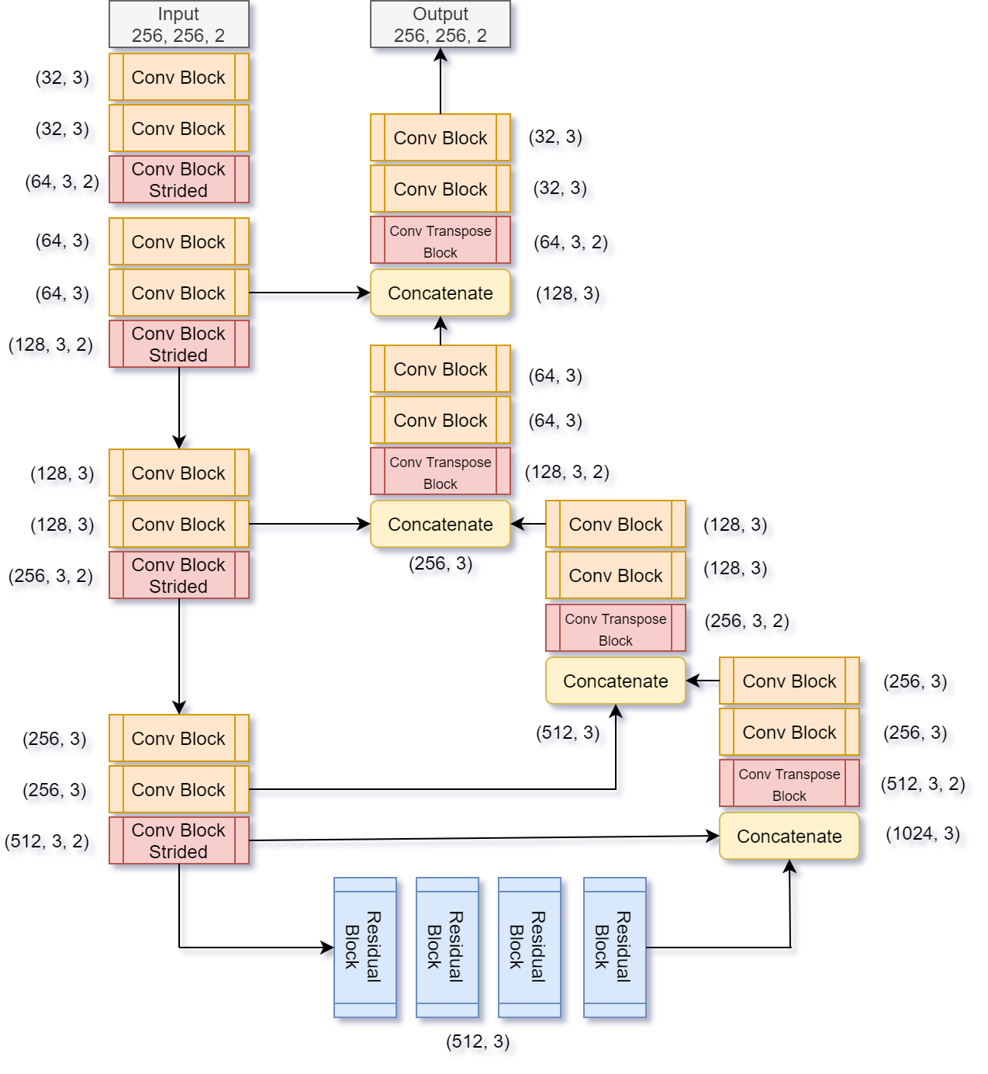
Base Model (DumbellXL) Architecture

Slide 8
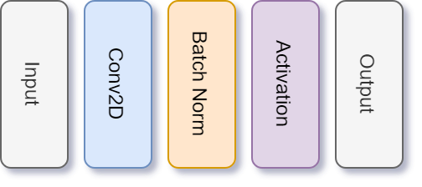
Convolutional Block (Strided)

Slide 9
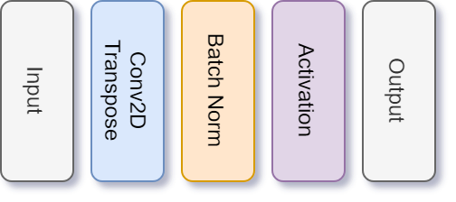
Convolutional Transpose Block

Slide 10
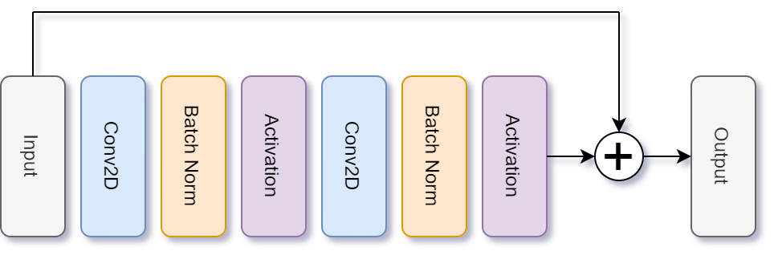
Residual Block

Slide 11
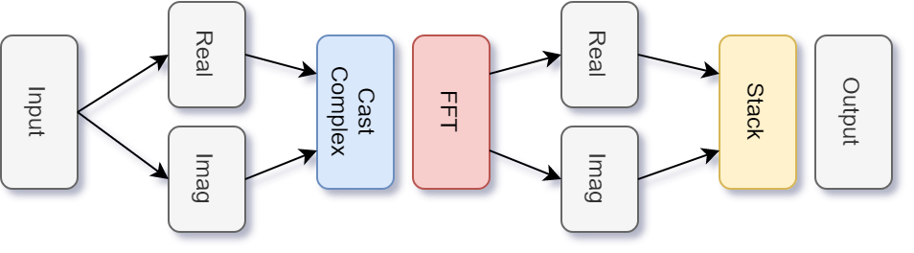
FFT Block

Slide 12
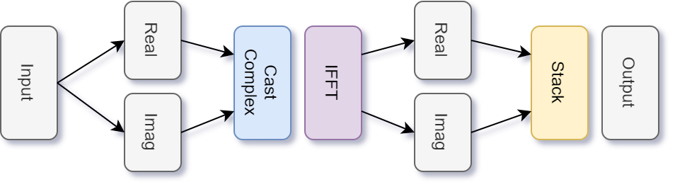
IFFT Block

Slide 13
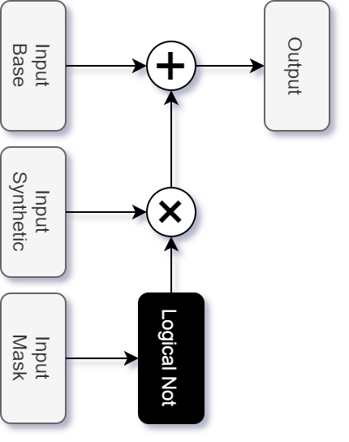
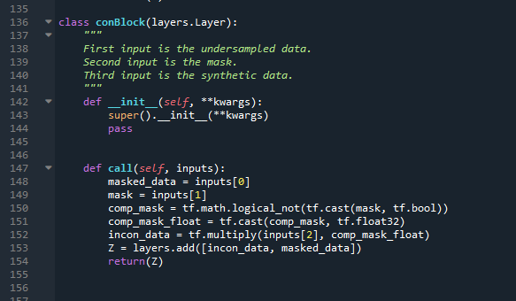
Consistency Block

Slide 14
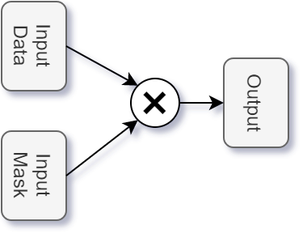
Undersample Block

Slide 15
Common Model Parameters
Optimizer: Adam
Learning Rate: 1e-3
Training: 20 epochs

Slide 16
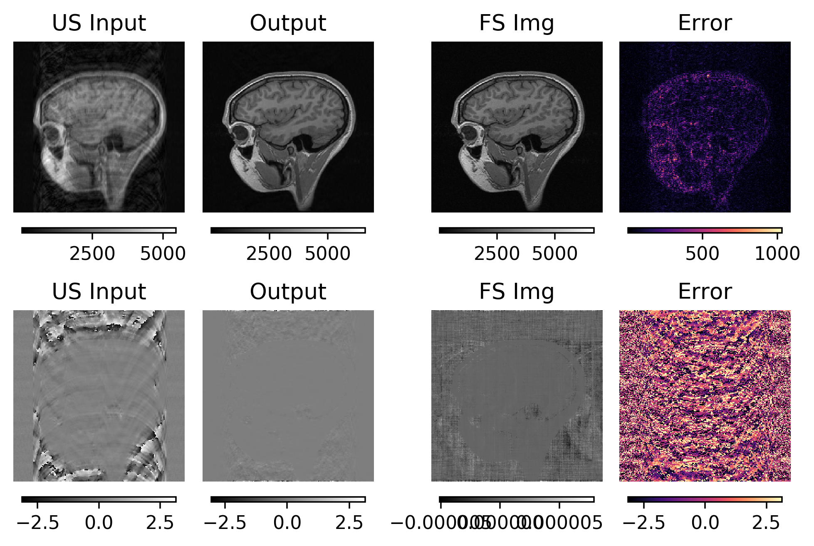
U-Net 2x
Parameters
Per model: 31,031,234
Total: ~62m

Slide 17
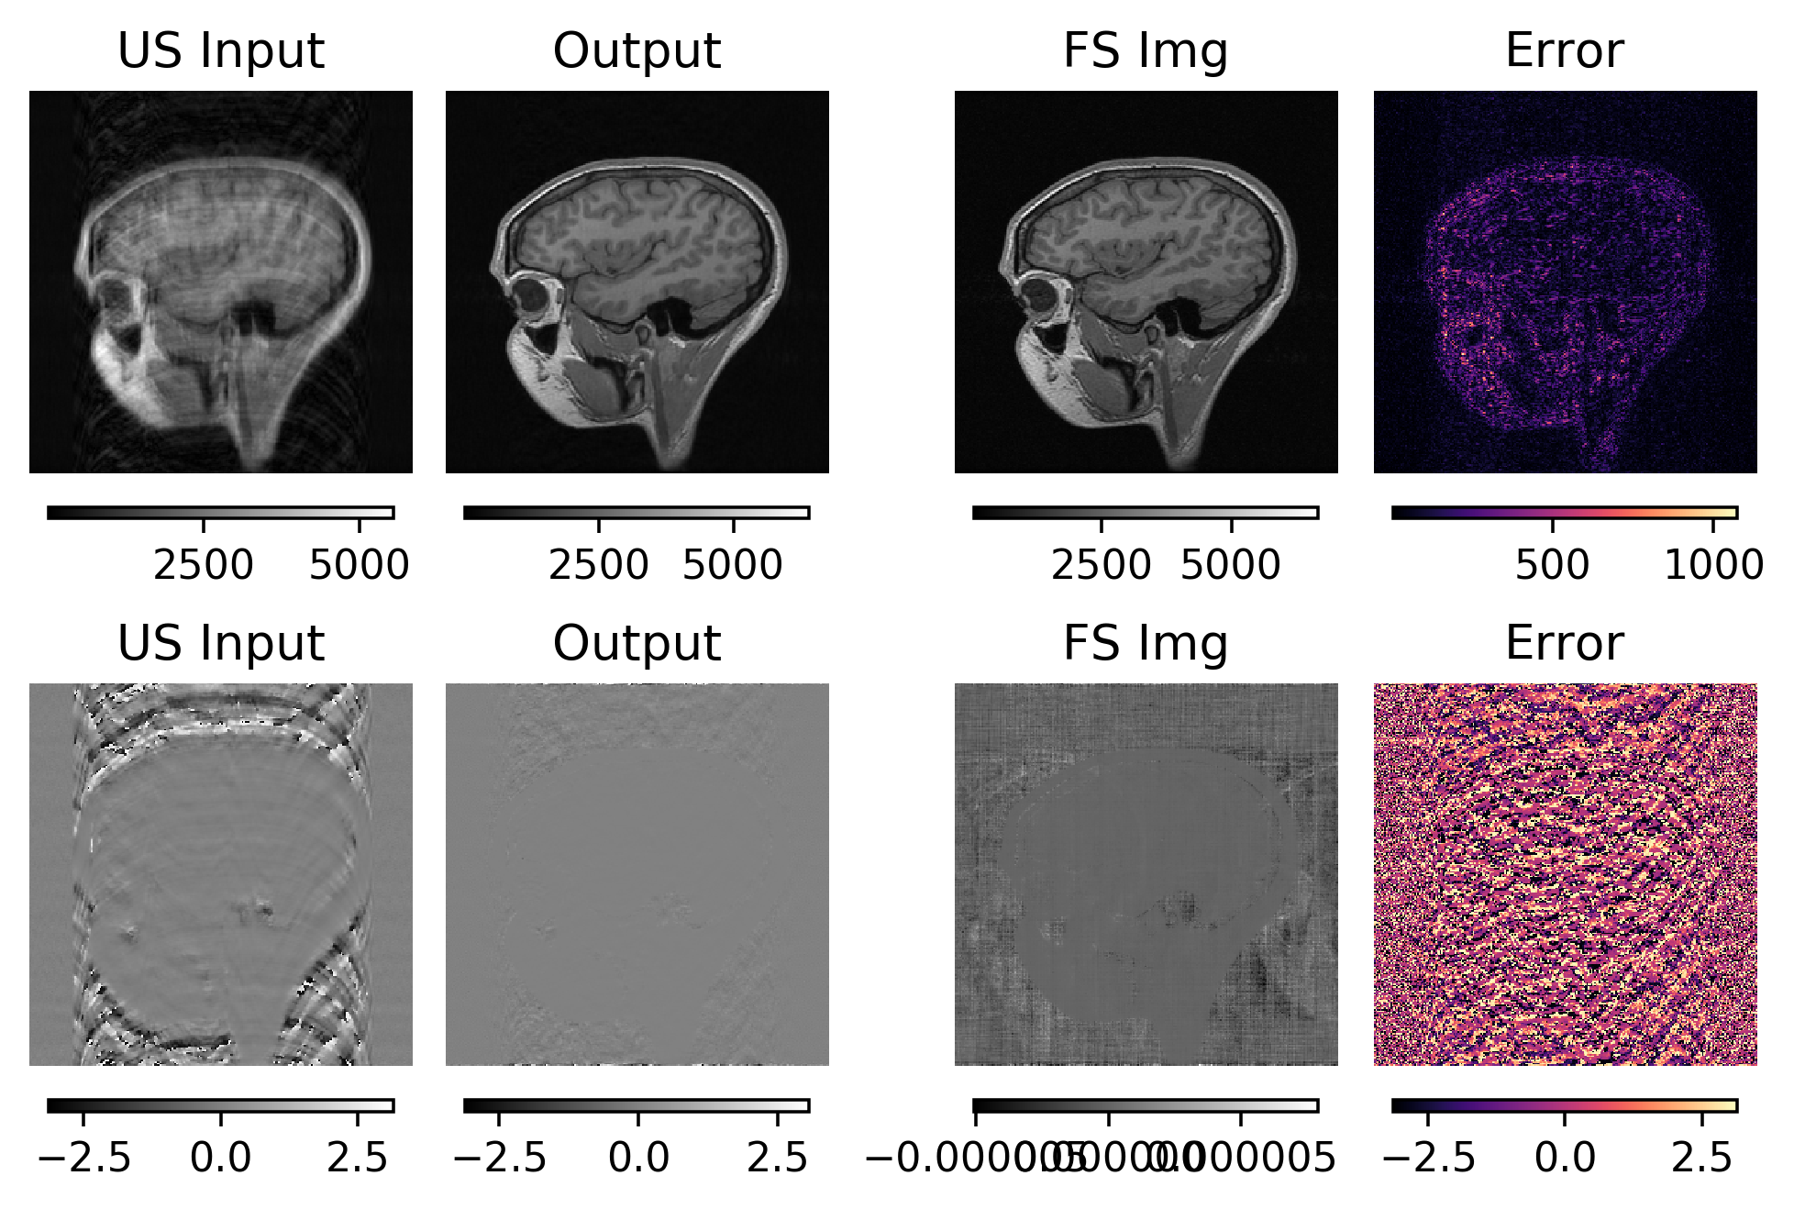
DumbellXL 2x (Add)
Parameters:
Per model: 21,208,960
Total: ~22.4m

Slide 18
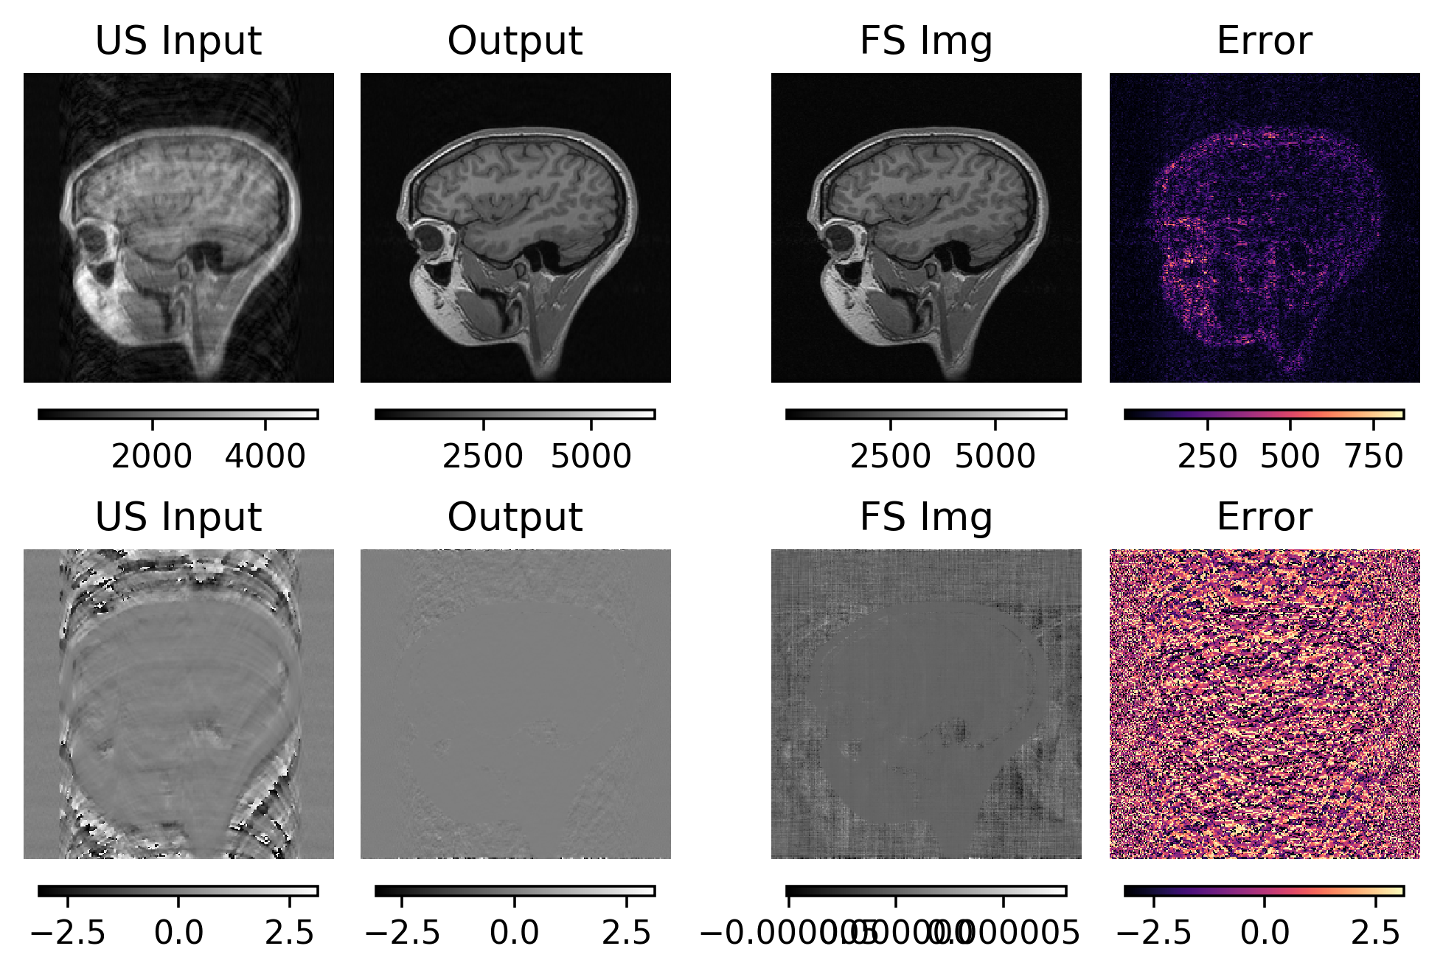
DumbellXL 2x (Concatenation)
Parameters:
Per model: 21,208,960
Total: ~22.4m

Slide 19
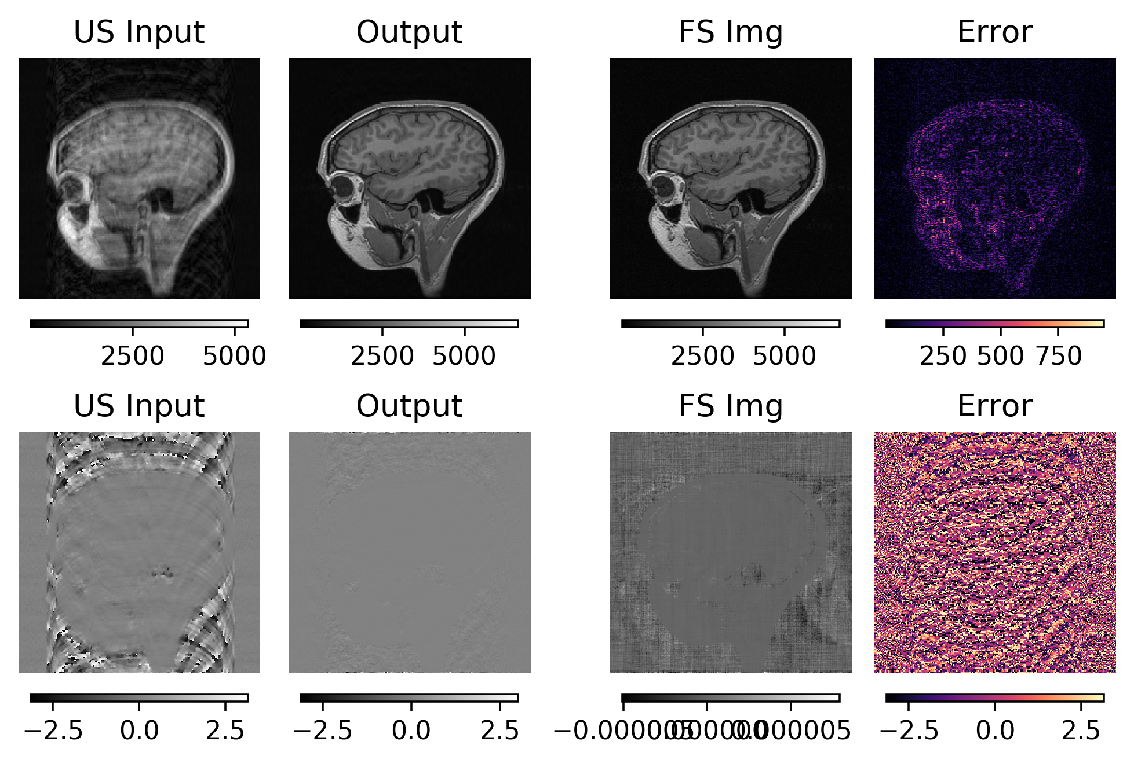
DumbellXL 3x (Concatenation)
Parameters:
Per model: 21,208,960
Total: ~63.6m

Slide 20
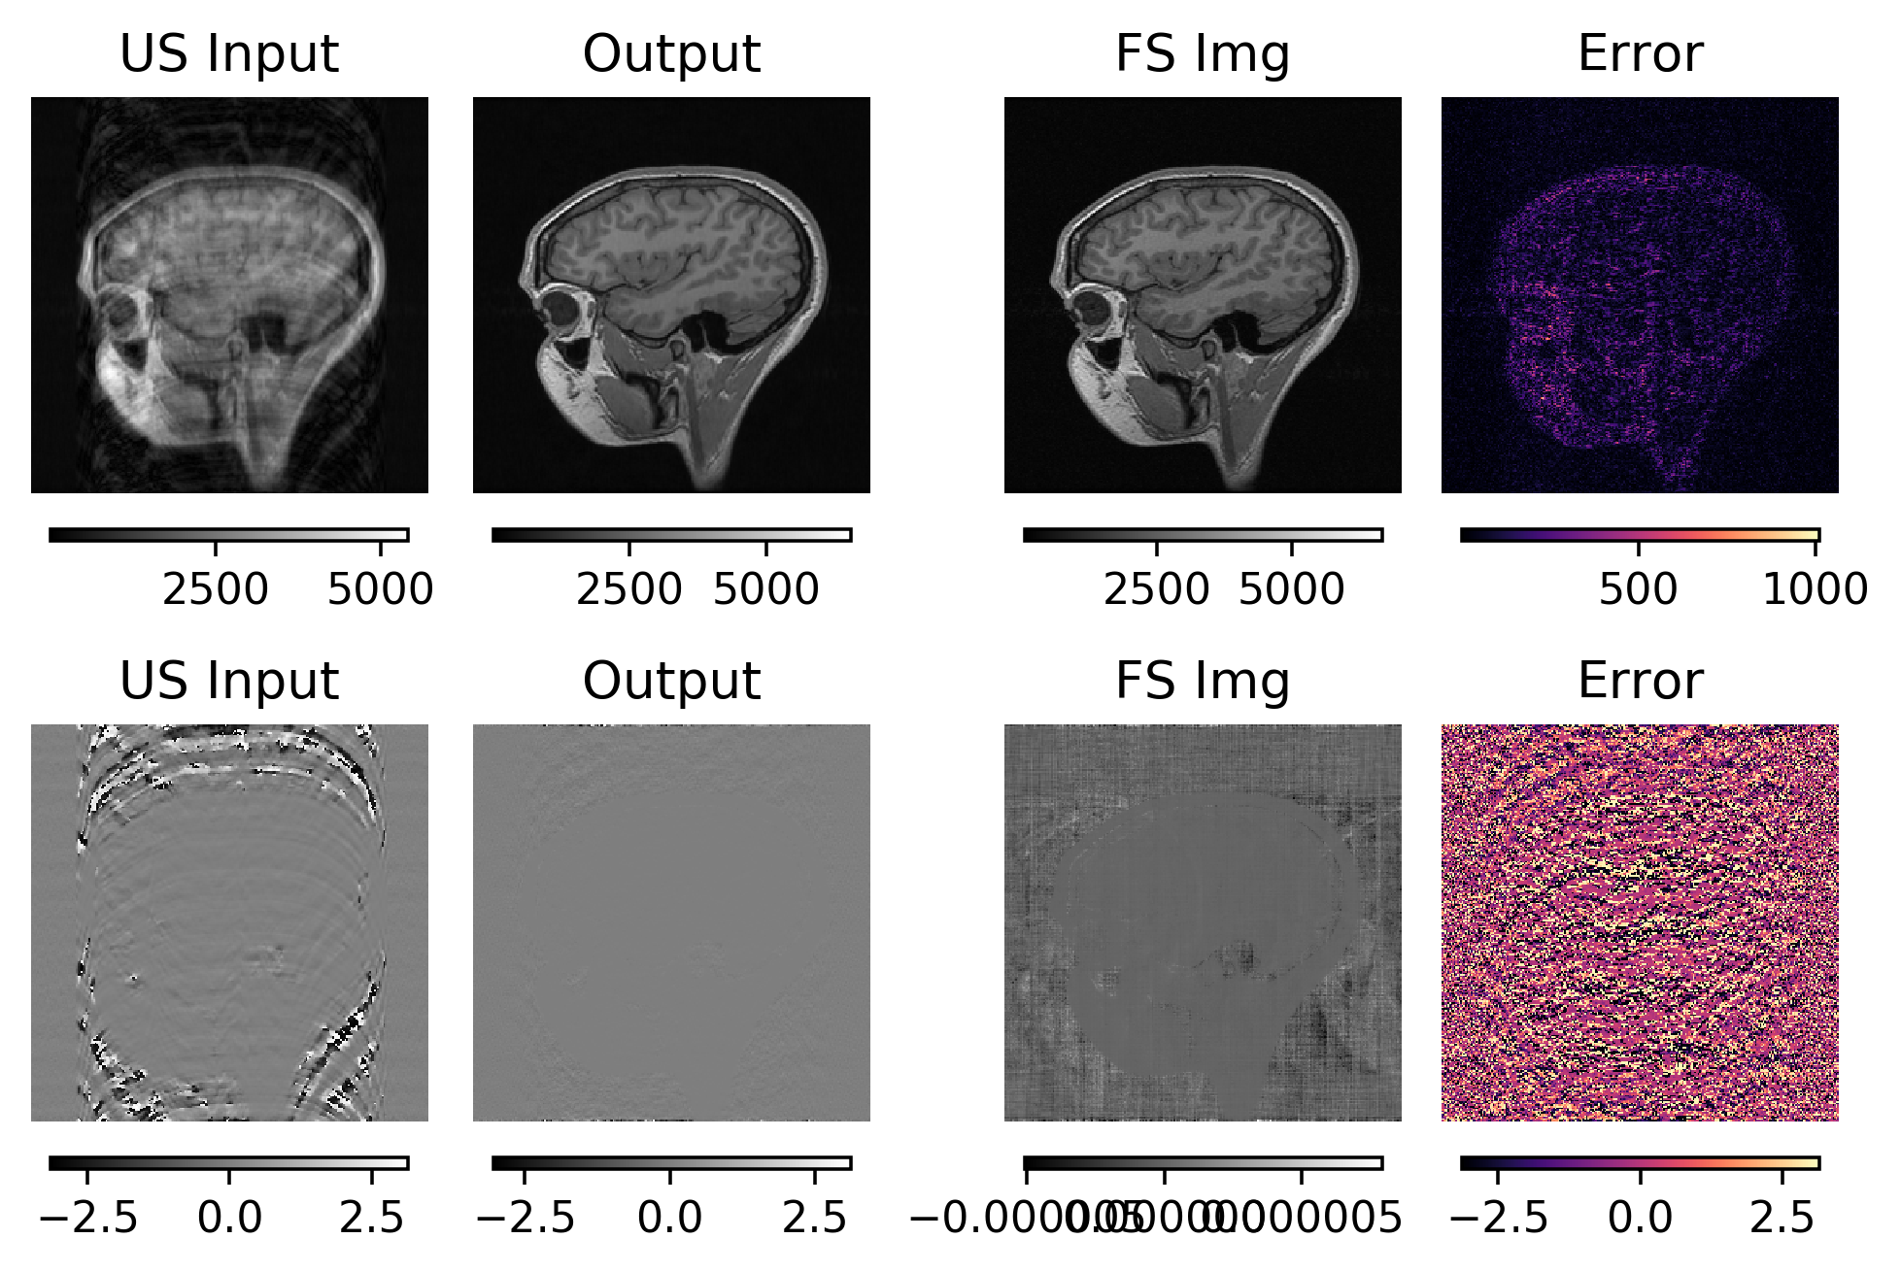
DumbellS 6x (Concatenation)
Parameters:
Per model: 5,402,368
Total: ~32.3m

Slide 21
Statistical Results

Slide 22
Side by Side Comparison
Undersampled
Fullsampled
U-Net 2x
DumbellXL 2x Add
DumbellXL 3x
Concat
DumbellS 6x
Concat
DumbellXL 2x
Concat

Slide 23
Conclusions
Concatenation produces better results.
U-Net is still better, however, DumbellXL and DumbellS can be chained more times.
DumbellXL requires it’s architecture to be fixed.

